Slide 1
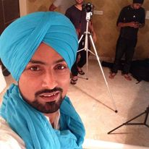





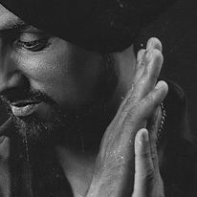




Amandeep Singh Heera-Punjabi singer
Heera is an Indian Punjabi-language singer and theatre actor. ... He is best known for his songs like Speciality and Mere Jinna Pyaar. ... He is also known for ...
9899968632
rapperadaboy@yahoo.com
Link
Link
Link1
NA
NA
NA
NA
NA

