Slide 1
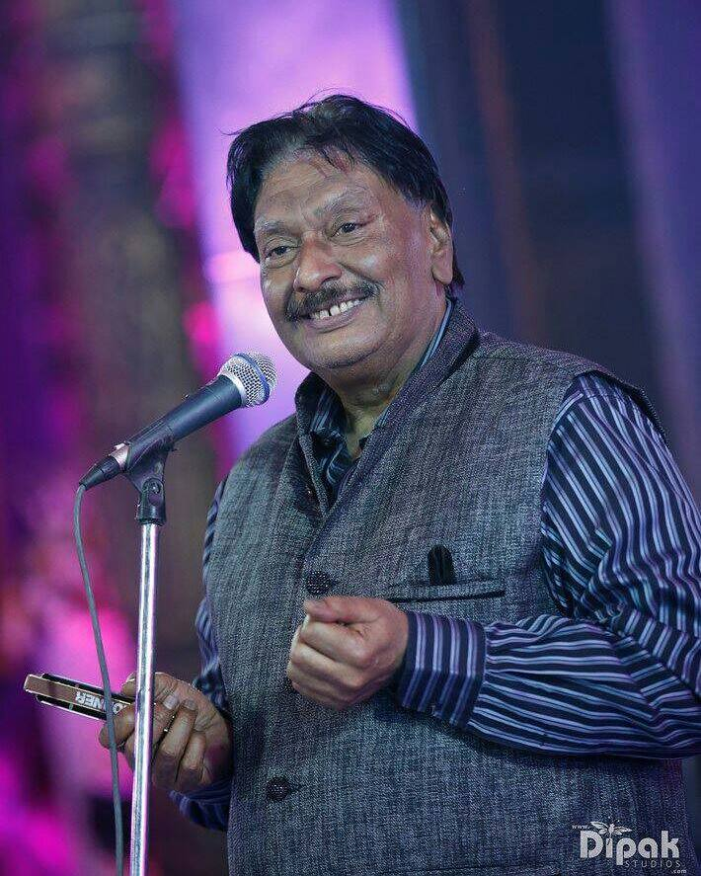
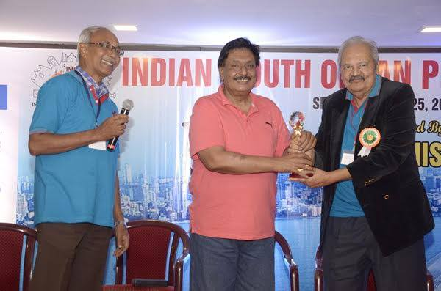

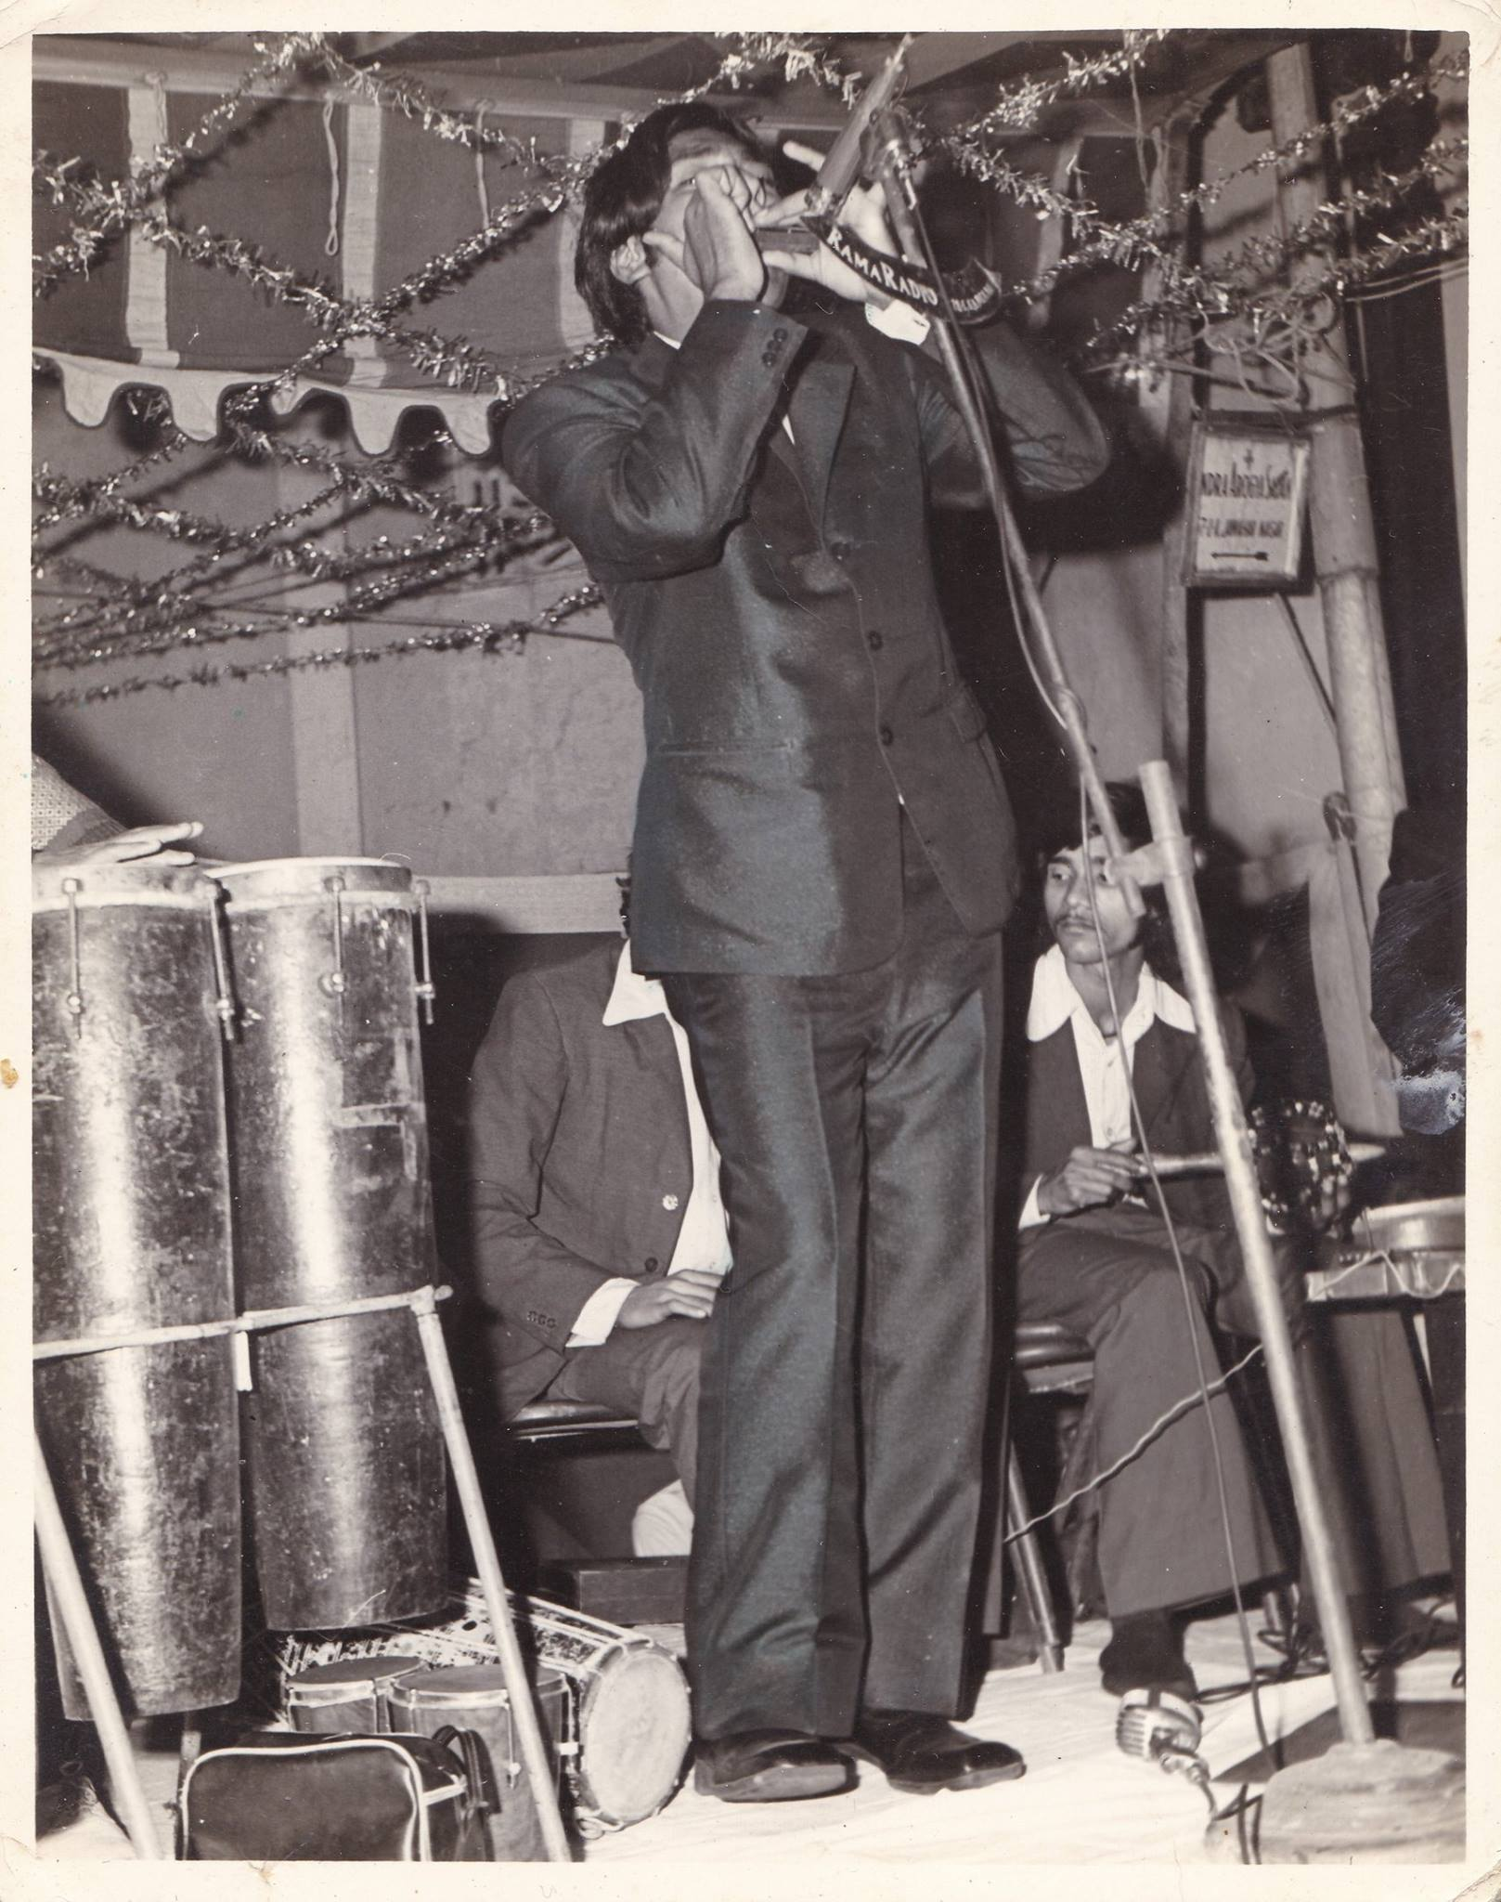

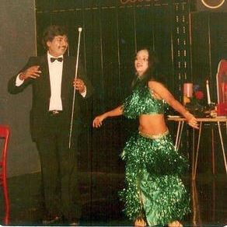



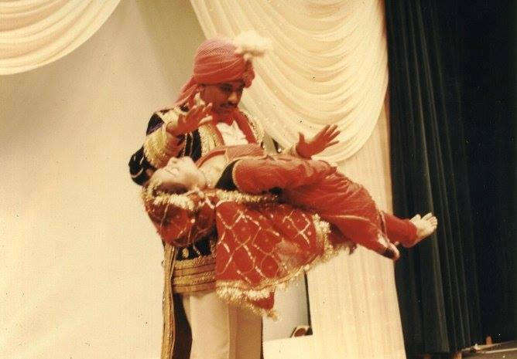

Ashok Bhandari- Magician
Ashok Bhandari was a magician and a Harmonica player; he is a man with many talents. The entrepreneur inside him convinced him to start making detergents when he was 15
9999902183/9899902183
mohini.upadhyaya@gmail.com
Link
LINK
Link
Link 3
Lnik
Link 2
Linkk1
Link

