Slide 1
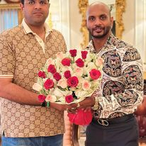

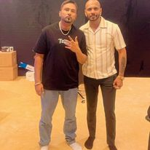








Girik Aman- Punjabi singer
Girik Aman is a professional singer based out of the capital city of India, New Delhi. This rising star needs no introduction
8800000672/9911028265
aman.songster@gmail.com
Link
Link
Link1
Link 2
Link 3
link 4
Link 5
NA

