Slide 1
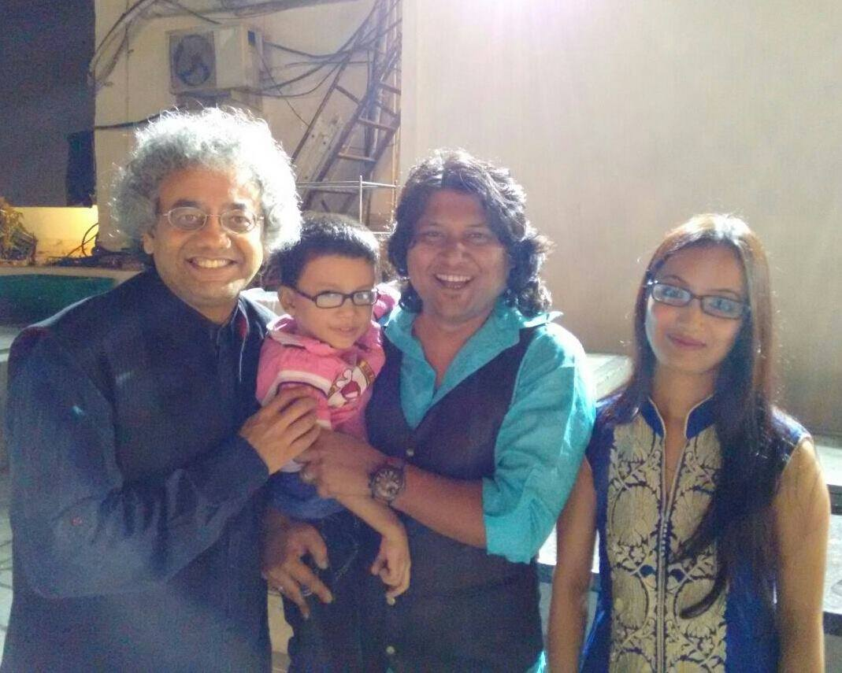







Lalit - Percussionist
Lalit Percussionist is a professional percussionist from Mumbai. He plays many instruments including drums, octoban, darbuka and kanjira.
9811620302
ls50ster@gmail.com
Link
NA
NA
NA

