Slide 1
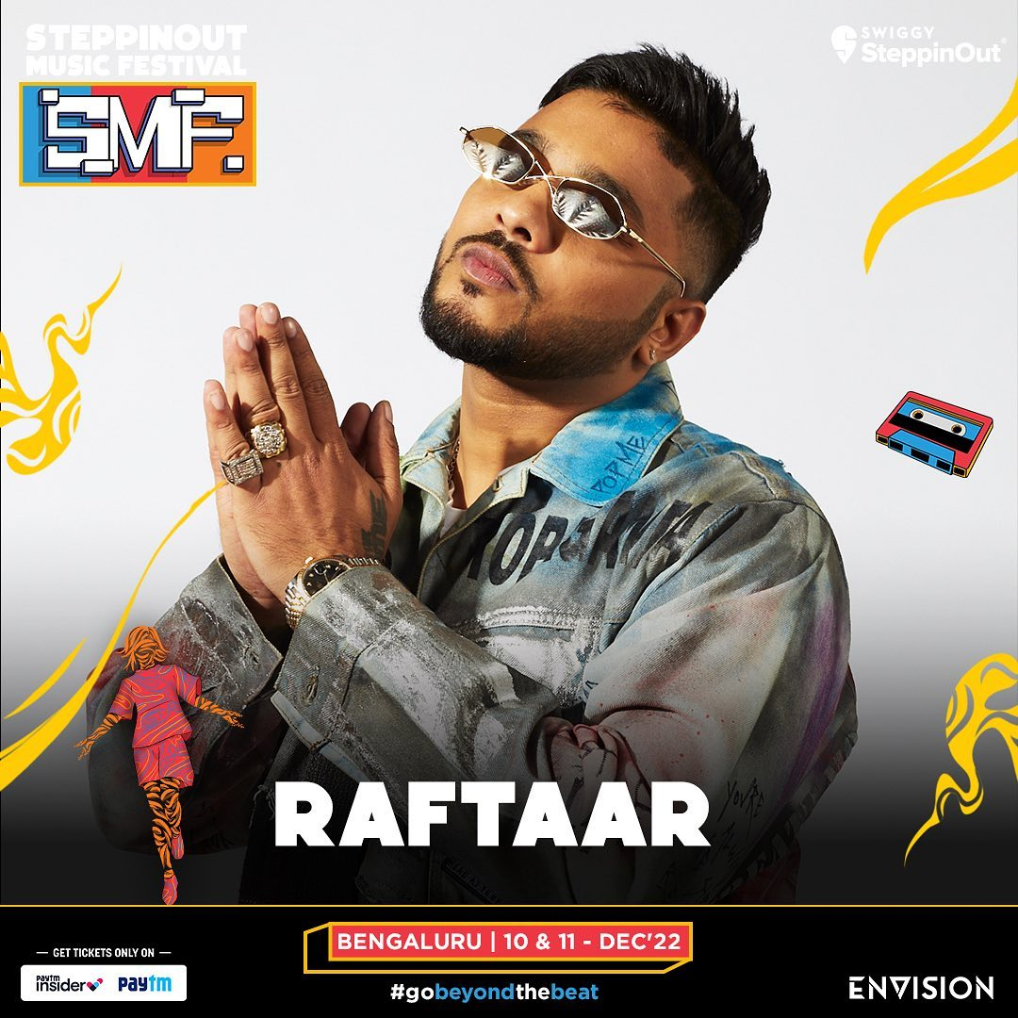
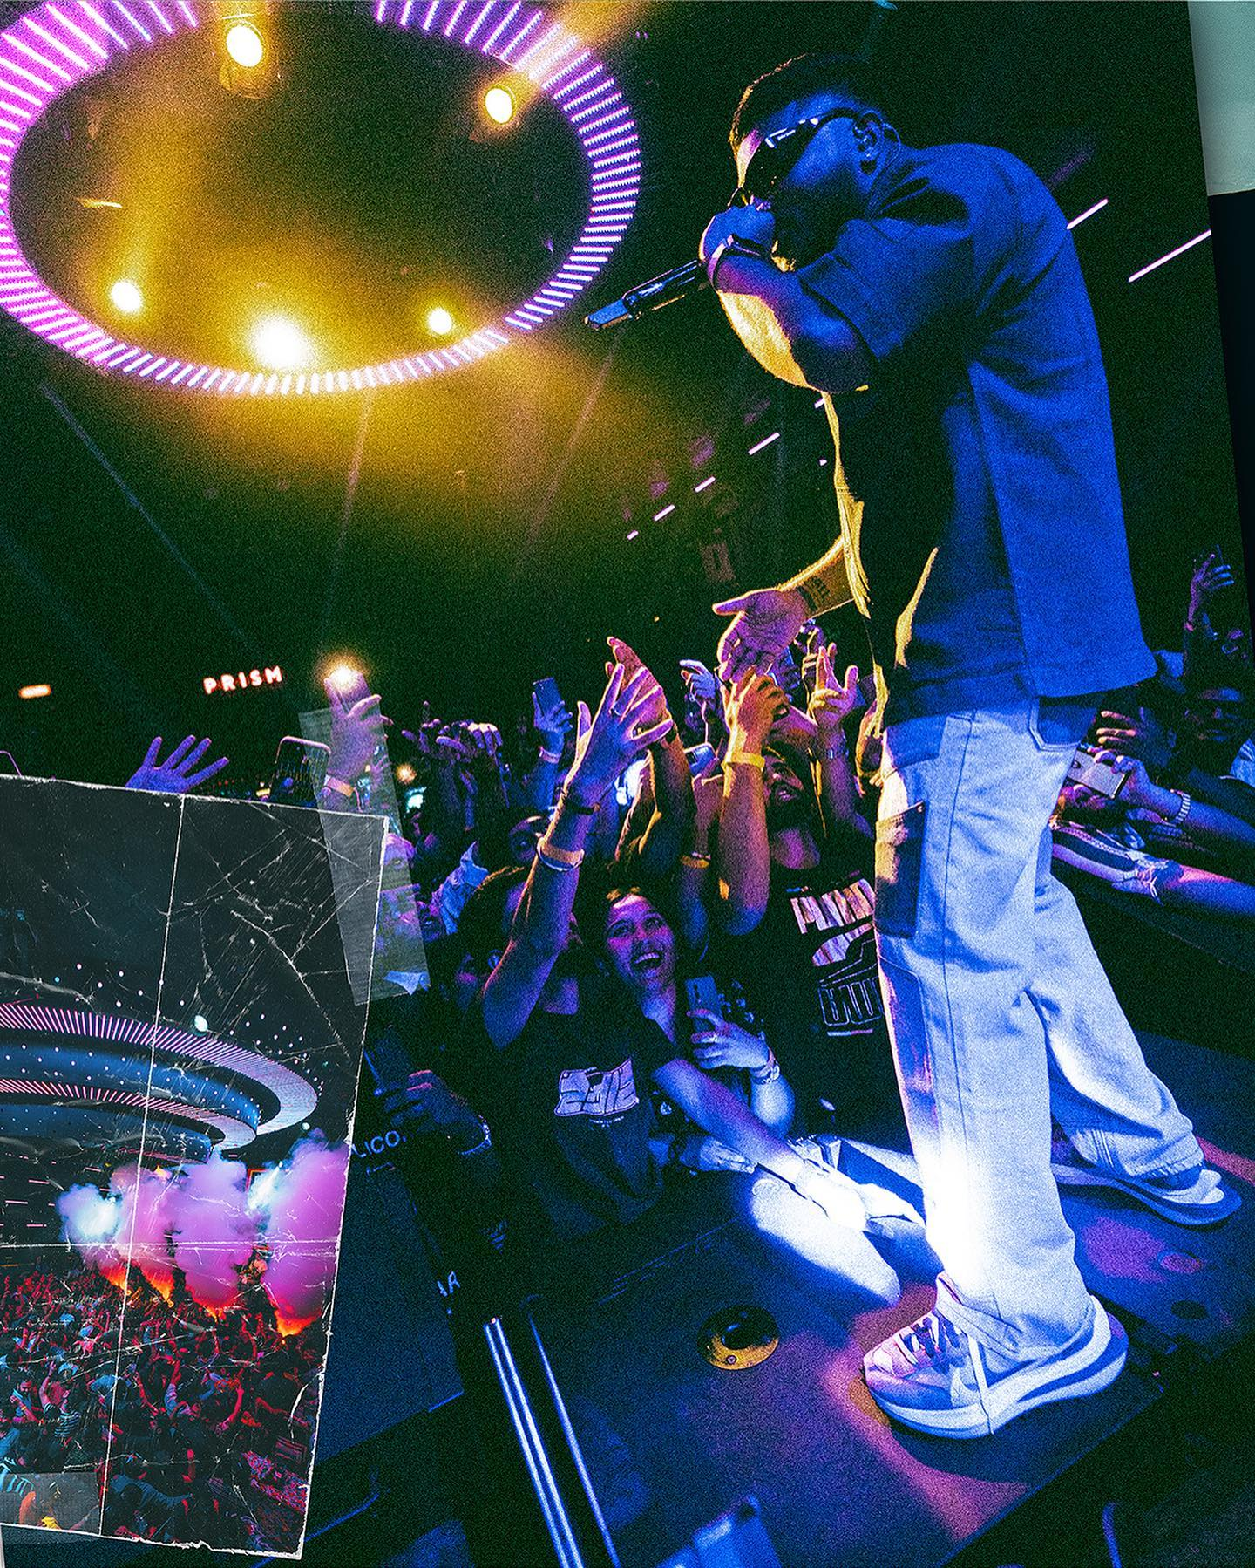
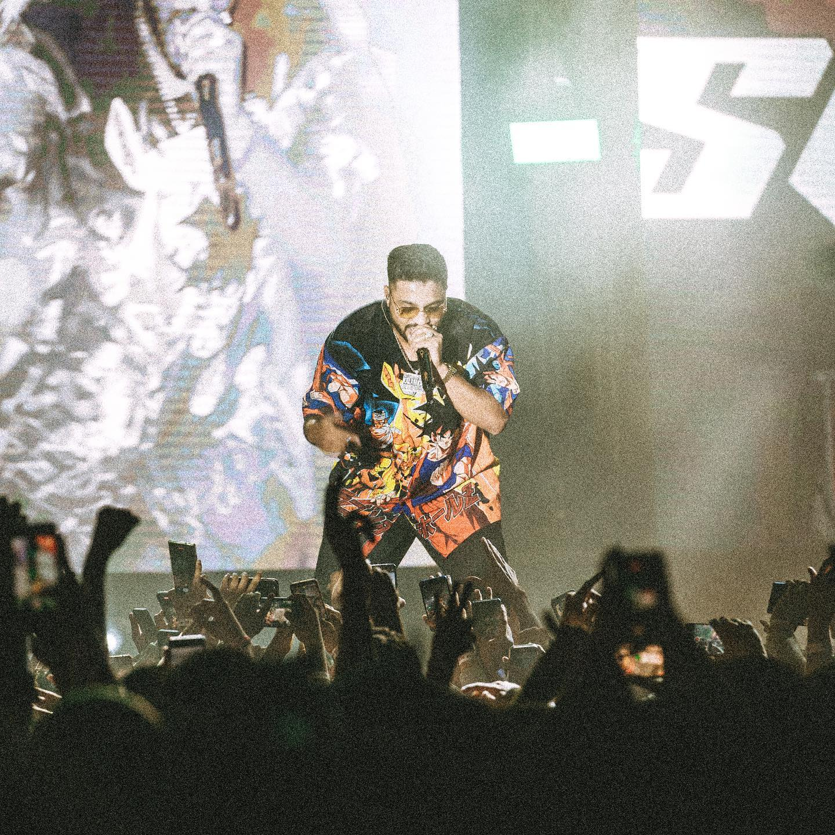


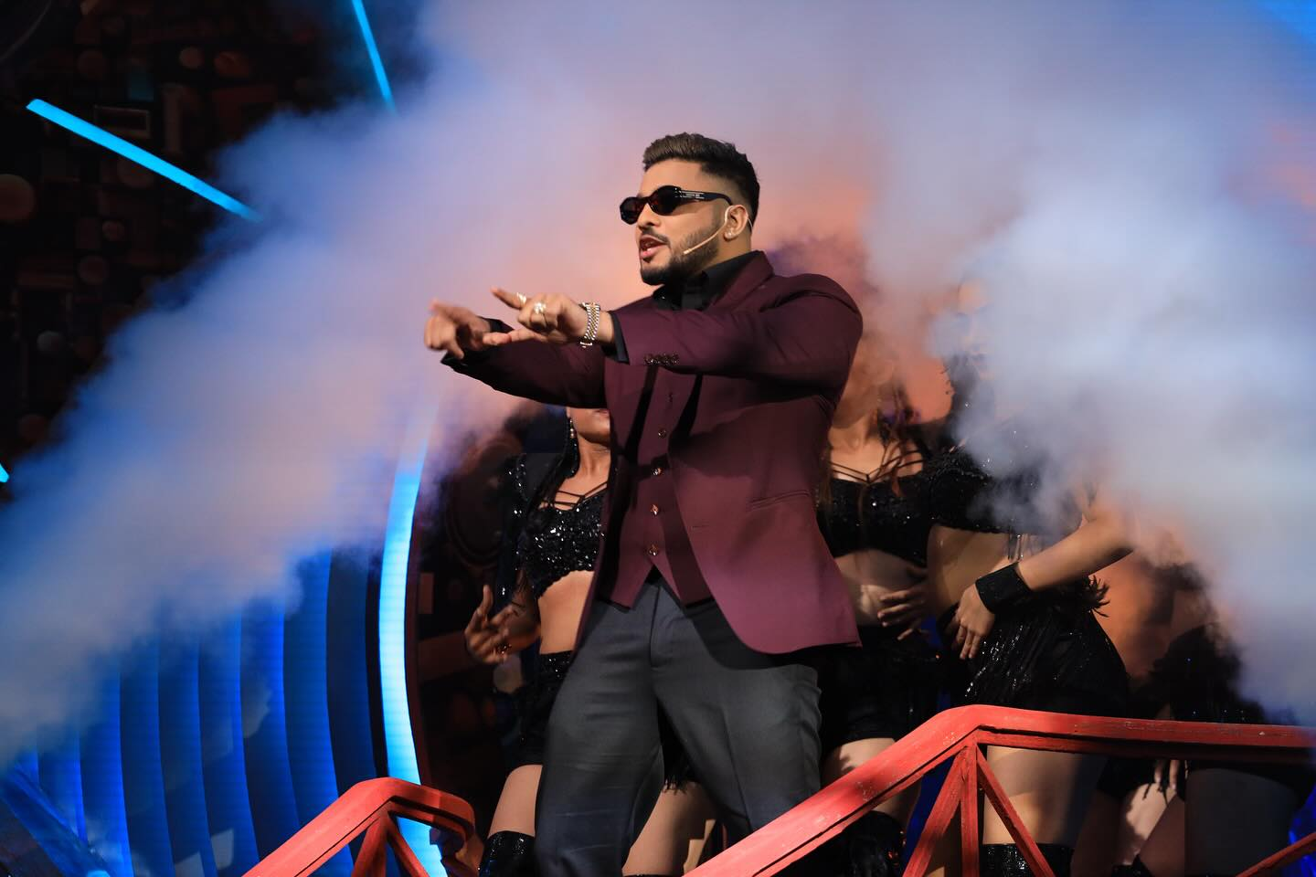

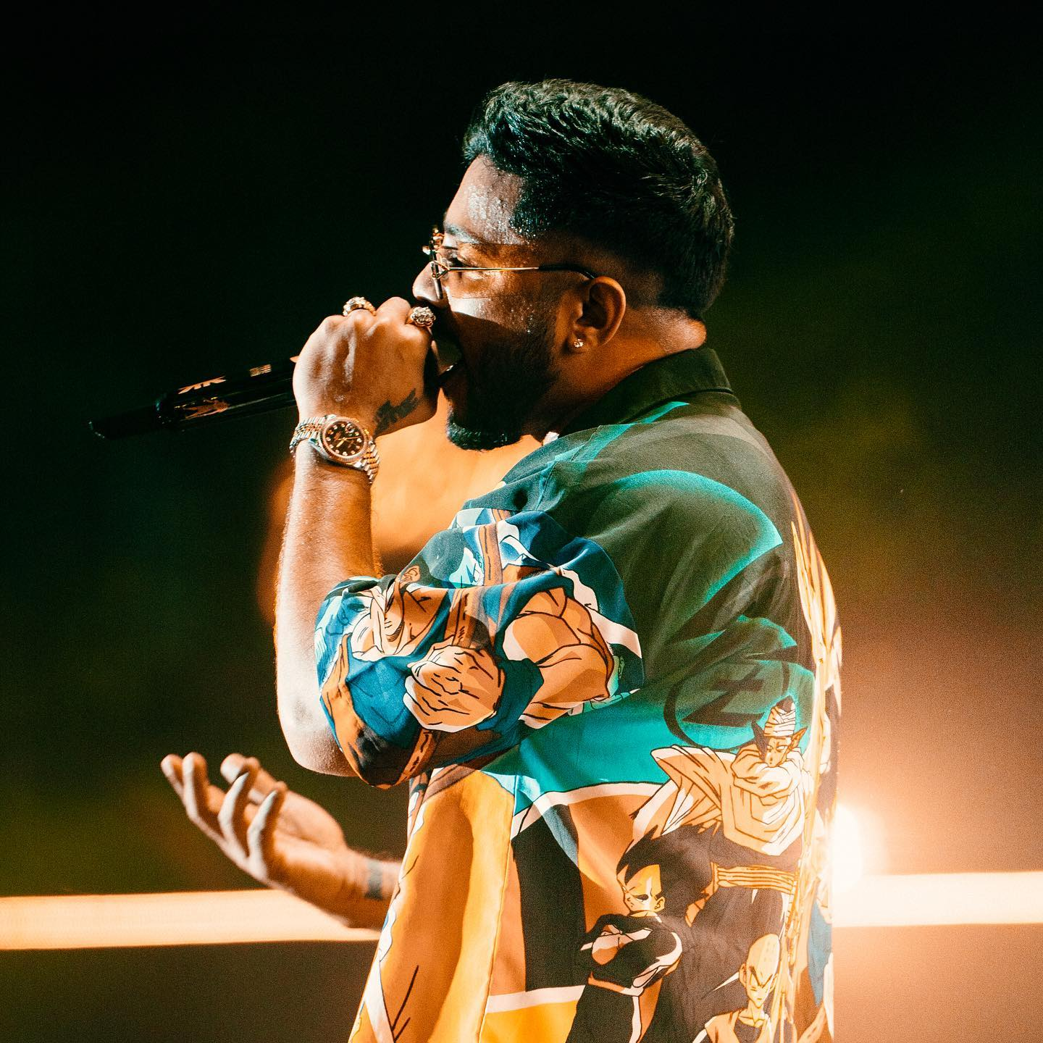



Raftaar- Rapper
Raftaar is an Indian rapper, lyricist, dancer, TV personality, and music composer who is popular for working on various Hindi and Punjabi music
8684087620
muzikonerecords@gmail.com
Link
LINK
link 4
Link 3
Link 5
Link 2
Link1
NA

