Slide 1
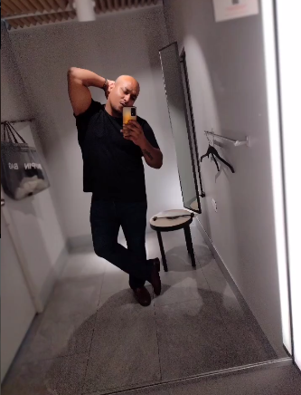
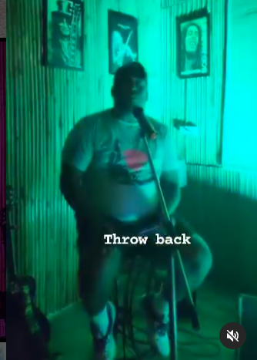
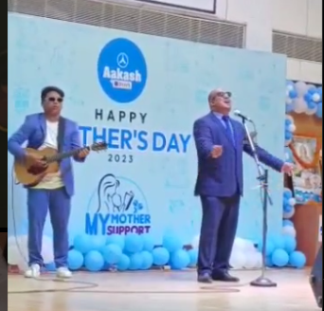



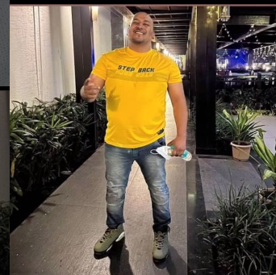
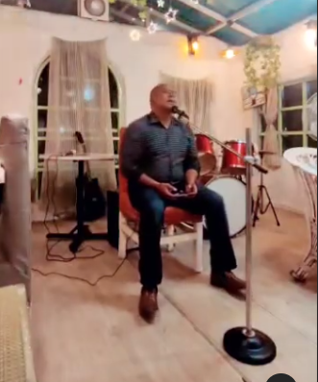



Rajeev Kumar Dhiman-Anchor
Rajeev Kumar Dhiman Professional karaoke Singer.
9212472488
rajeev_dc22@yahoo.com
Link
Link
Link1
Link 2
Link 3
link 4
Link 5
NA

