Slide 1

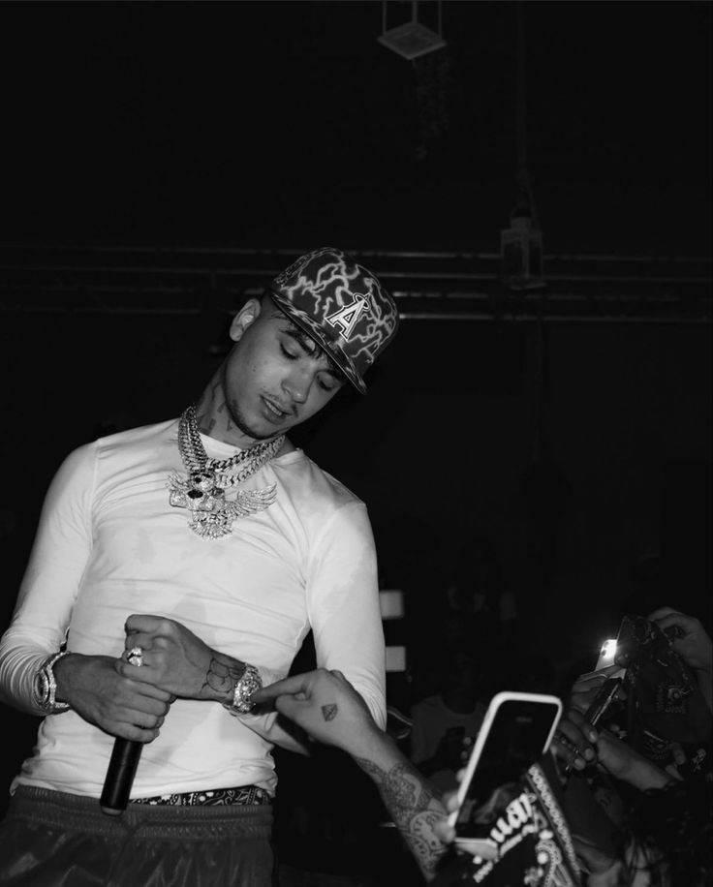






Shiva-Rapper
Shiva, stage name of Andrea Arrigoni (born August 27, 1999) is an Italian rapper and singer. He debuted with the studio album Tempo anima in January 2017.
8527336835
NA
Link
LINK
link 4
Link 3
Link 5
Linkk 2
Link1
NA

