Slide 1
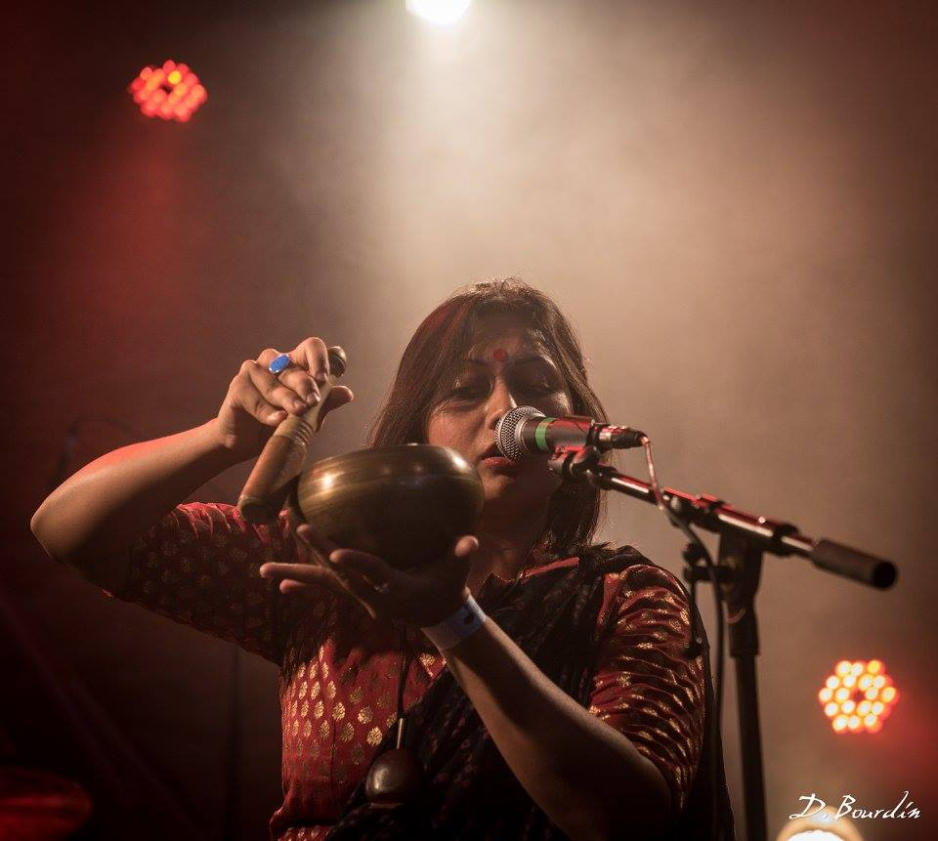
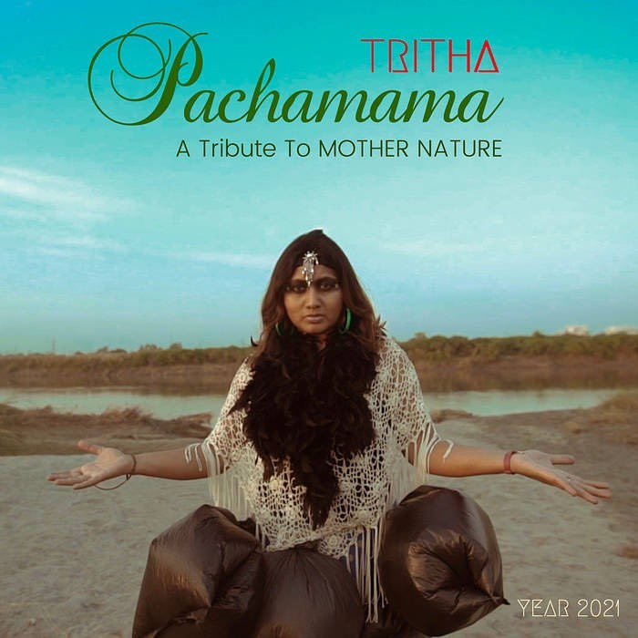

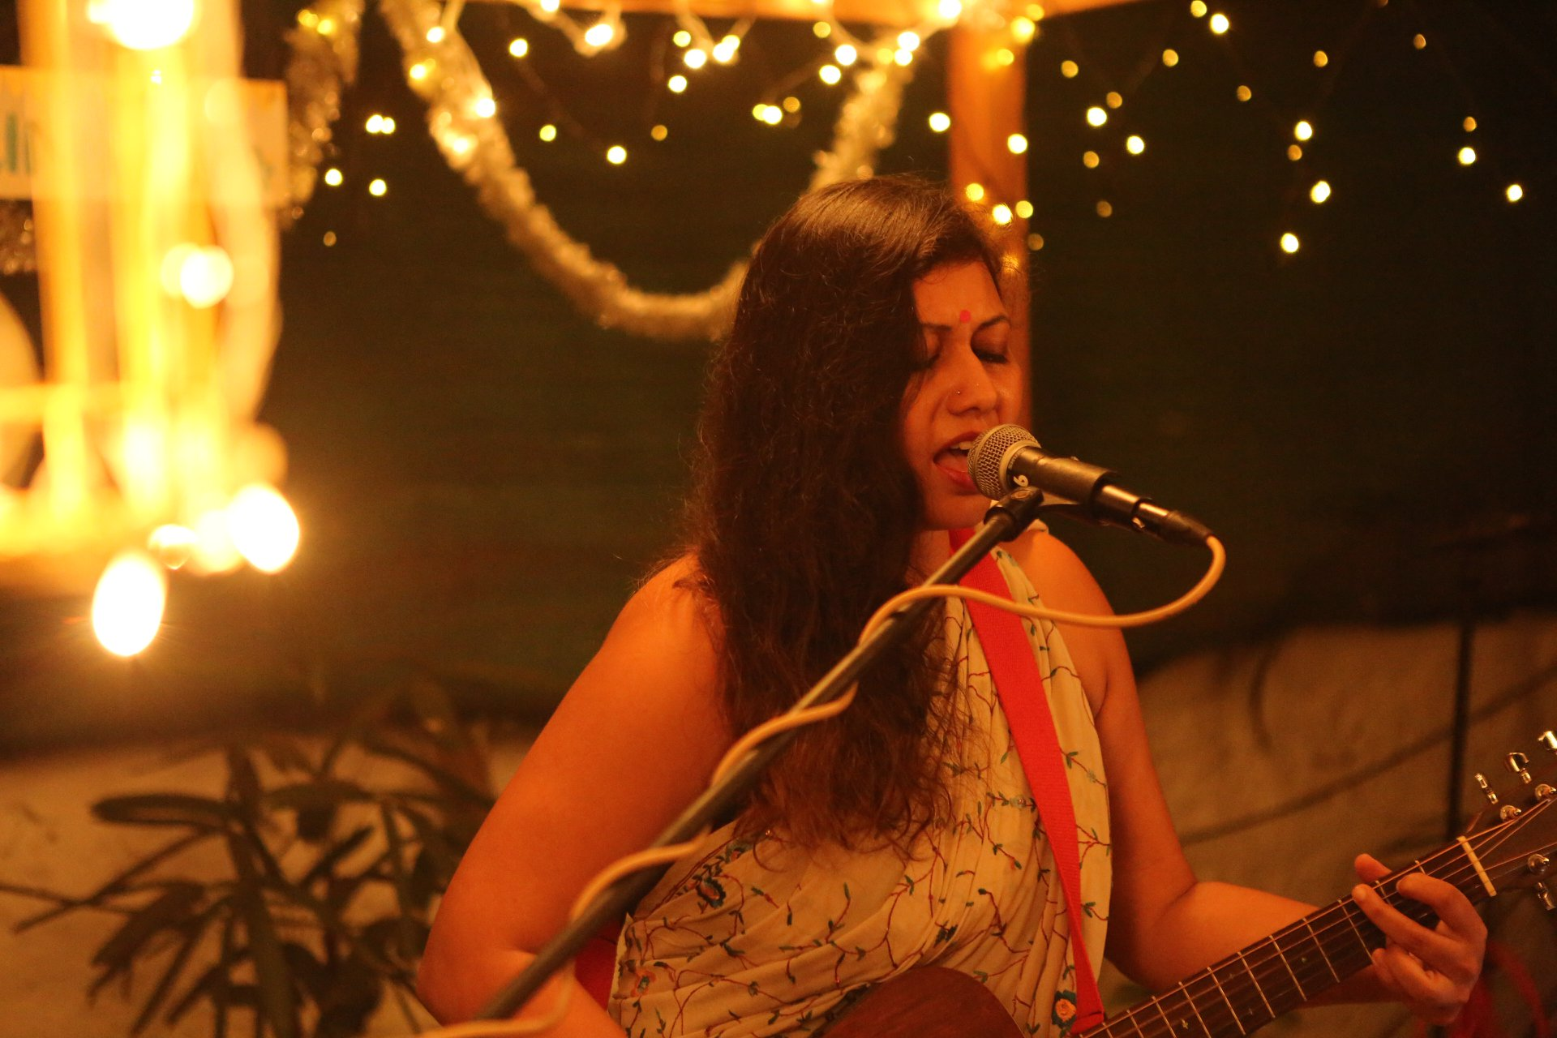




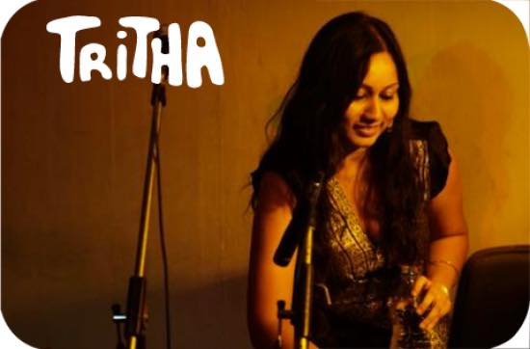


Tritha Sinha - Singer
Tritha Sinha Performed at the Cannes Film Festival 2019 in France, Tritha is a vocalist, composer and music producer based out of India and France. Trained in North Indian classical music and Dhrupad for over 25 years, she blends this rich form with her contemporary expression and songwriting.
9654382040
booktritha@gmail.com/trithasinha@gmail.com
Link
LINK
link 4
Link 3
Link 5
Link 2
Link1
Link

