Slide 1

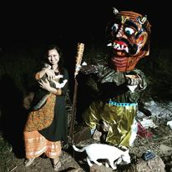
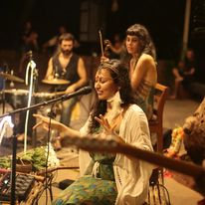








Tritha - Music Band
One of India’s most promising musicians and gifted singer, songwriter and composer, Tritha is a rising figure in the world. She was invited to perform at the Cannes film festival 2019 in France for her music activist score in the “Coup de Cœur” award winning film – “Voyage for Change”. Travelled over 18 countries with her concerts and workshops, Tritha has 16 albums to her credit with her different projects. She is based presently in Goa
9654382040
booktritha@gmail.com/trithasinha@gmail.com
Link
NA
Link1
Link 2
Link 3
link 4
Link 5
Link

