Slide 1
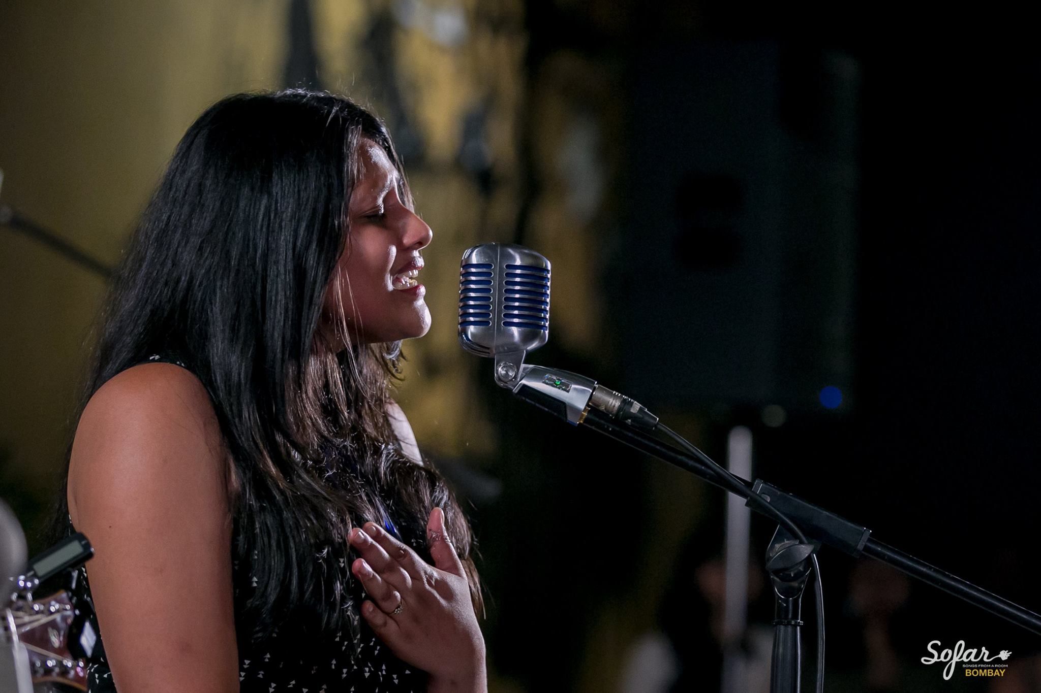


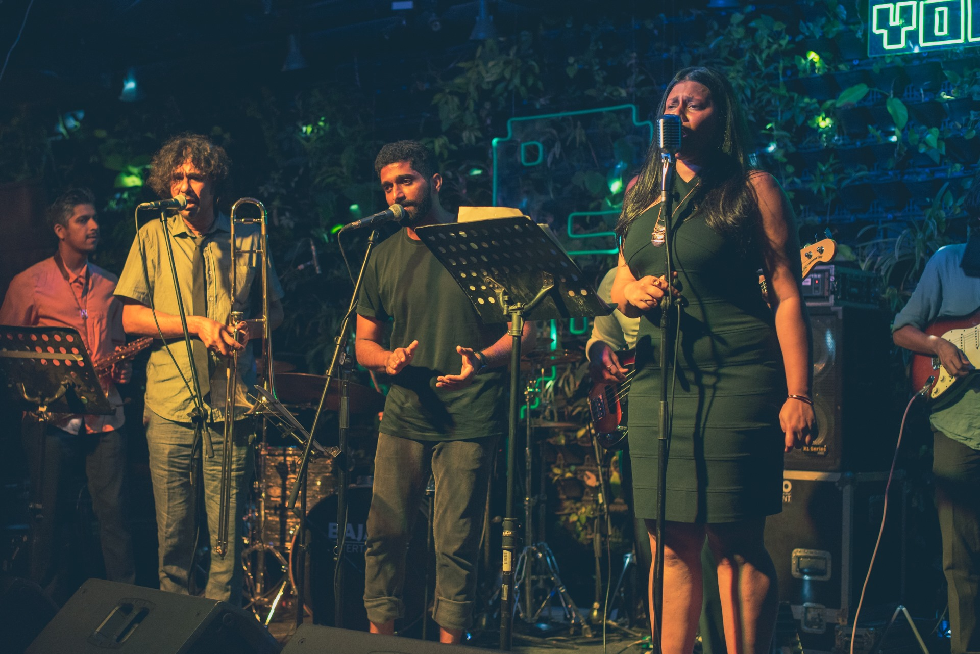

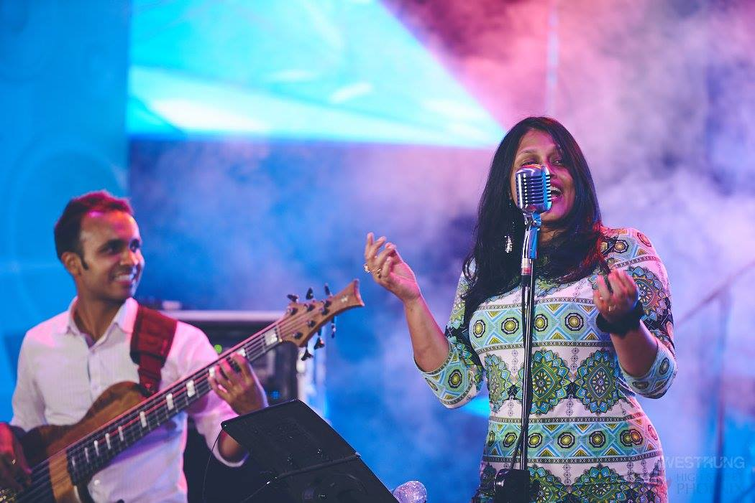


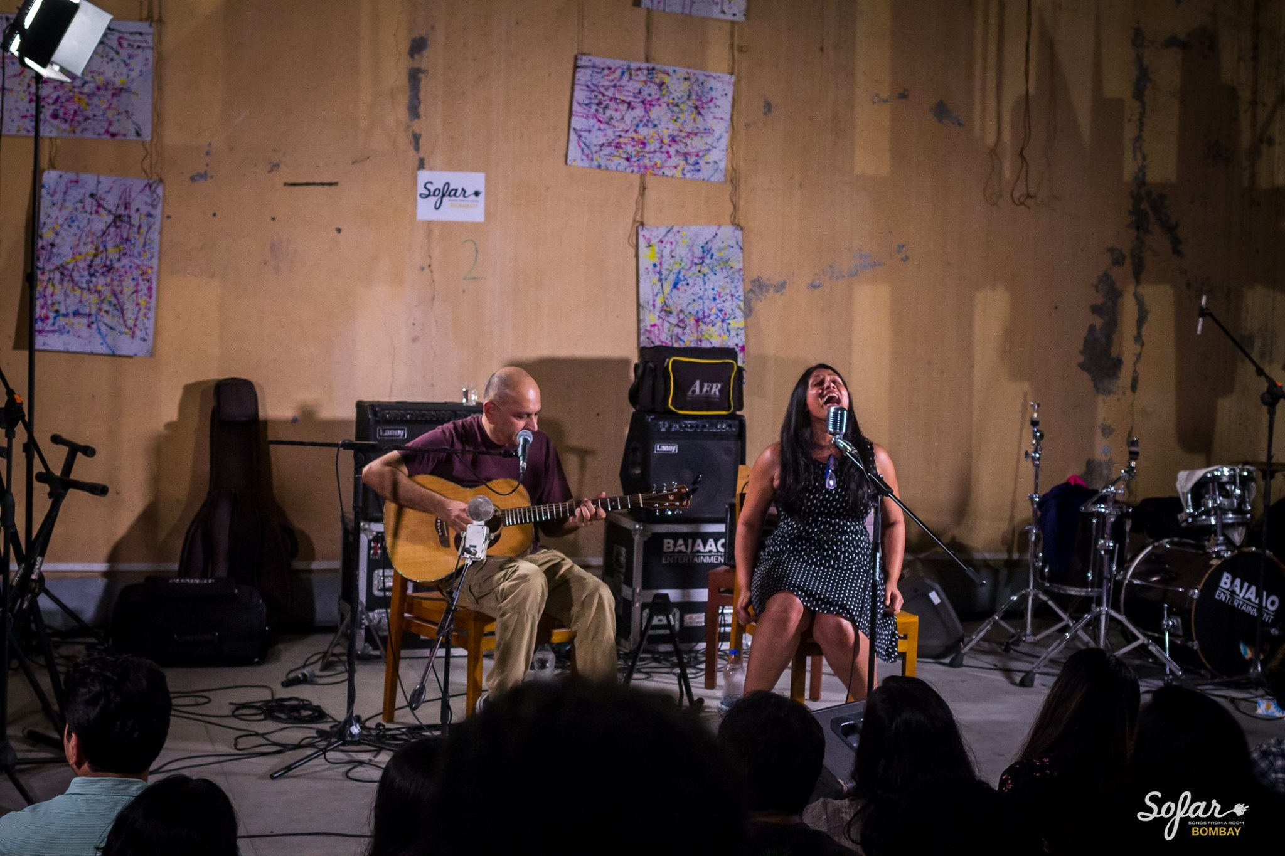


Vasundhara Vee - Singer
Vasundhara Vee is an award winning Jazz and Soul singer known for her evocative power-vocals, high-groove concerts and compelling vocal depth.
9899331275
indieviants@gmail.com/blue.zephyrs@gmail.com
Link
LINK
link 4
Link 3
Link 5
Link 2
Link1
Link

